Slide 1
Welcome!
REDCap + R Workshop
REDCapCon 2023

Slide 2
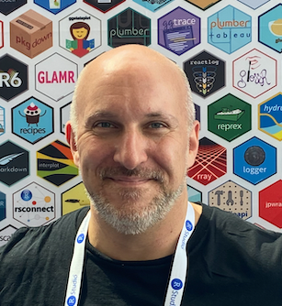
Stephan
Notes:
TODO: bio

Slide 3
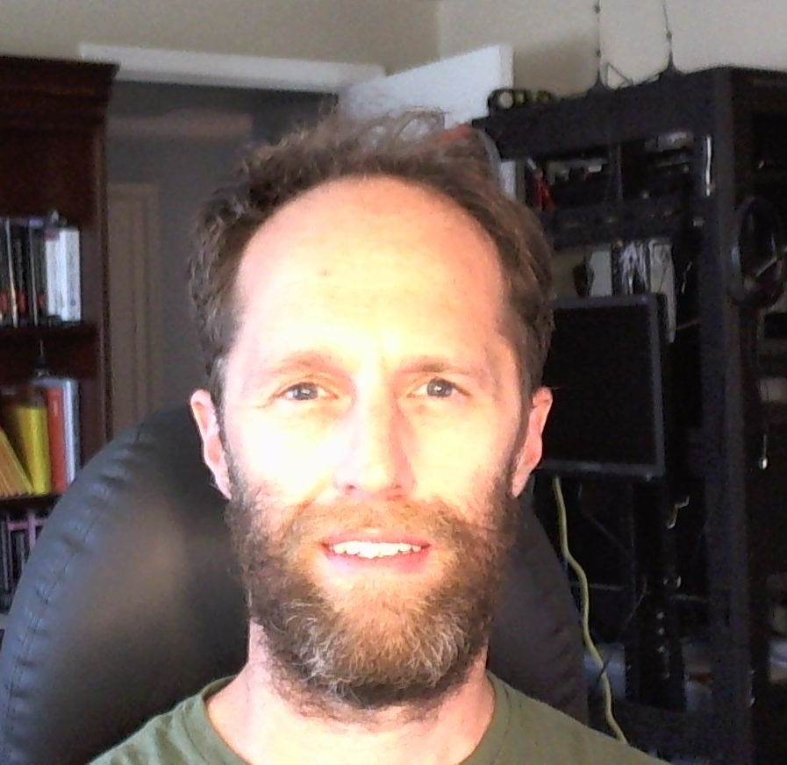
Will
Notes:
TODO: add headshot

Slide 4

Assumptions
You are somewhat familiar with REDCap
You have basic knowledge of R
You're interested in learning how to integrate REDCap and R so you can use these skills for your own work
You'd like to meet others who are also interested in this
Notes:
… but don't necessarily have in-depth knowledge about complex databases with repeated and longitudinal instruments
… but aren't necessarily an expert in using it to clean, visualize, or model data
…or at least aren't opposed to meeting them!

Slide 5
Getting Onto Posit Cloud
Notes:
Posit Cloud training environment that we’ve set up specifically for this course so you don’t have to download anything. However after the course we highly recommend you download the RStudio IDE from the Posit website. It’ll look very similar to this.

Slide 6
https://posit.cloud/content/6465016
Notes:
Log in or sign up if you don’t have an account.

Slide 7
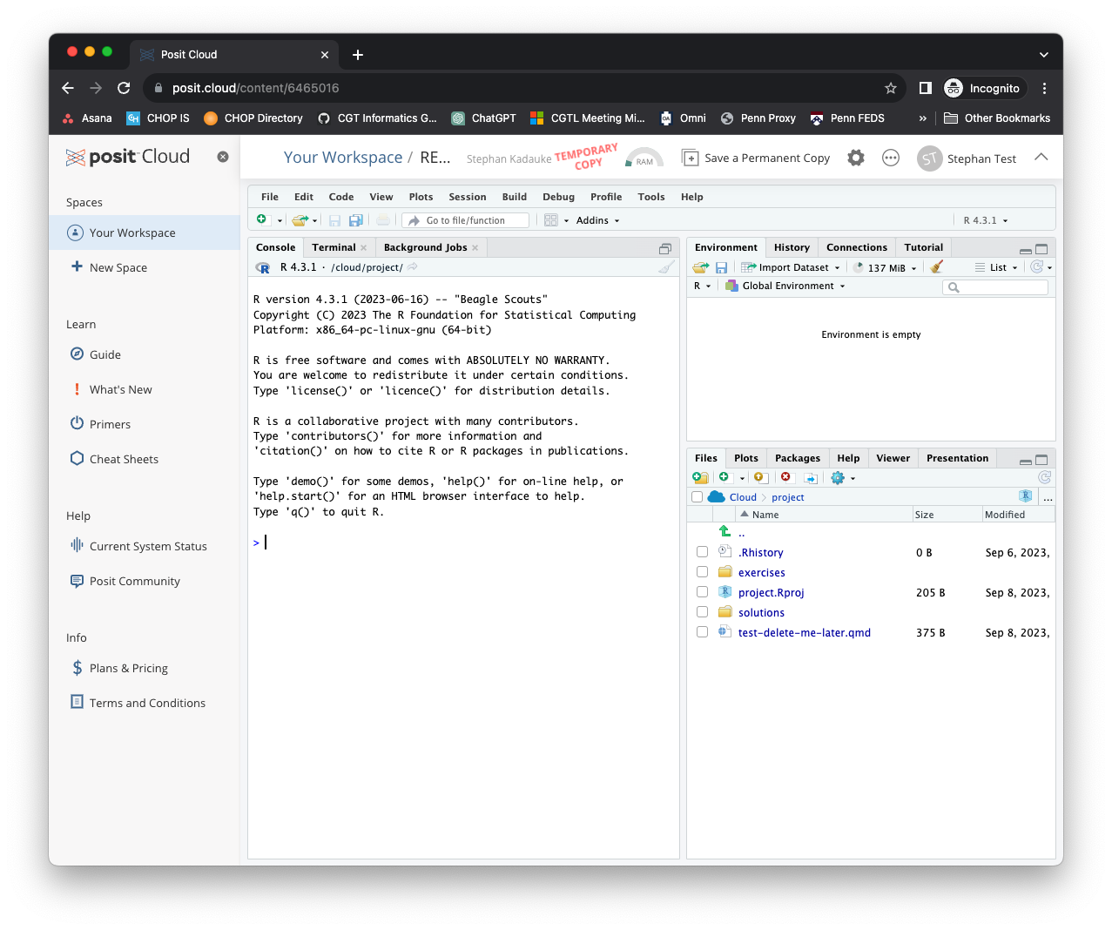
Notes:
X out the left sidebar so you have more real estate on the screen
Click on `exercises`
Then `00_

Slide 8
Your Turn
In the Files pane on the bottom right, find the exercises folder. Click on it.
Then click on the file named 00_welcome.qmd.
A new pane will pop up with the contents of that file. Read what it says and follow the instructions to complete the exercise.

Slide 9
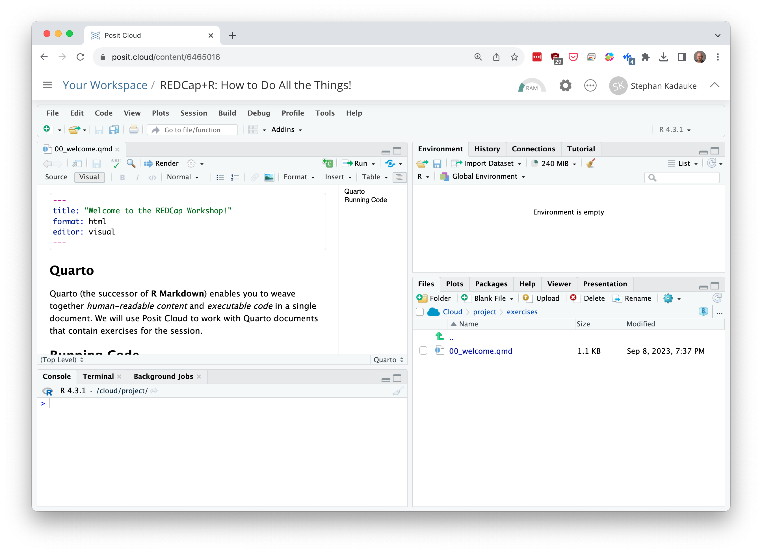
Environment
Editor
Files
(and other stuff)
Console
Notes:
Here’s what the Posit Cloud IDE looks like.
On the top left is the editor. This is where you enter code.
On the top right is the Environment. The environment allows you to look at the data that’s loaded into R. Interacting with data in the environment tab provides some of the functionality you may be familiar with from working in Excel.
The Console is on the bottom left. You can use the console quickly run an individual R command, like install a package. We won’t use the console today.
The pane I have labeled “Files and other stuff” has a few of tabs. The most important one for today is the “Files,” and you’ve already explored that. But here’s also where help pages for R commands will show.

Slide 10
Your Turn #1
Use green Tw Cen MT 44 for text
Use blue Monaco 36 for code
Be explicit about mode of feedback (e.g.: Click “yes” when you are finished.)

Slide 11
R Markdown
Notes:
(Might wan to mention here – next few min will be background and not critical to understand the rest, so if there are issues with logging into the server, please have TAs help troubleshooting now.)

Slide 12



Recap
Write 1-2 sentences to recap each major point of the session
Have a visual representing the section to the left
Notes:
To recap what we covered up to this point, …
(**) Analyzing data with with Excel, or similar spreadsheet software, can compromise data quality, and may ultimately lead to patient harm. This is because Excel does not record user interactions and it’s easy to make simple errors that can be very difficult to uncover later.
(**) Instead, you could use a reproducible workflow in which the entire analysis is automated with computer code, and we looked at how doing that can improve your confidence in the validity of an analysis.
(**) and finally, we defined “computational document” as documents that have executable code inside of them and we went over how computational documents are a key ingredient of reproducible workflows.

Slide 13
What else?
Notes:
The “What Else?” section should mention things that would be covered in a comprehensive course and/or are of strong interest to the intended audience

Slide 14
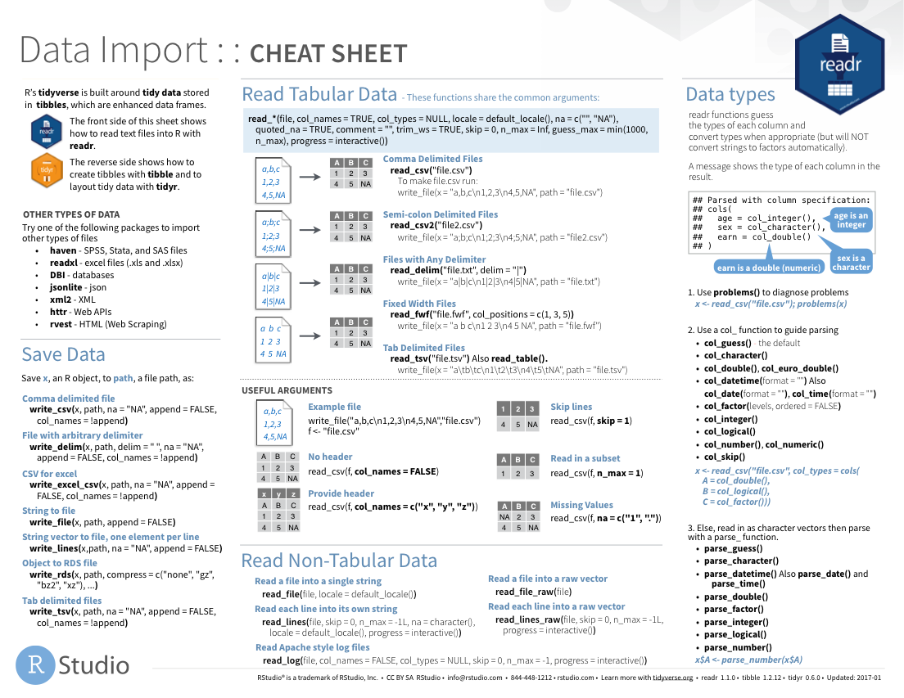
Notes:
Cheat sheets would go here

Slide 15
Notes:
As would other packages that do things

